Slide 1

Newton’s 3rd Law

Slide 2
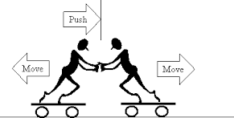
Title: Newton’s Third Law
Newton’s third law states: For every action force, there is an equal and opposite reaction force.
This is often worded as 'every action has an equal and opposite reaction'. However, it is important to remember that the two forces:
Act on two different objects
Are of the same type (eg both contact forces)

Slide 3
Pushing water backwards
They rebound into the air
Bullet leaves gun
Air pushes
bird upward
Jumper pushes downwards
Wings push down on air
Raft is pushed backward
Gun recoils back
You dive forward
Swimmer moves forward
Example | Action | Reaction
Shooting a gun
Trampoline
Person swimming
Diving off a raft
Bird flying

Slide 4
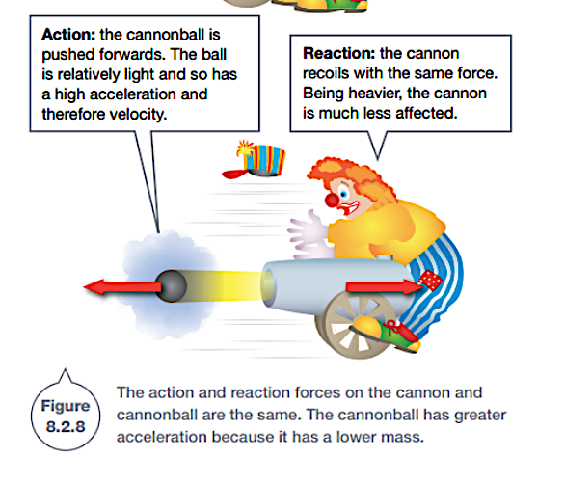
Newton’s Third Law
In your own words, explain why
A gun recoils when a bullet is fired.
The gun does not recoil with the same acceleration as the bullet
https://www.youtube.com/watch?v=TVAxASr0iUY

Slide 5
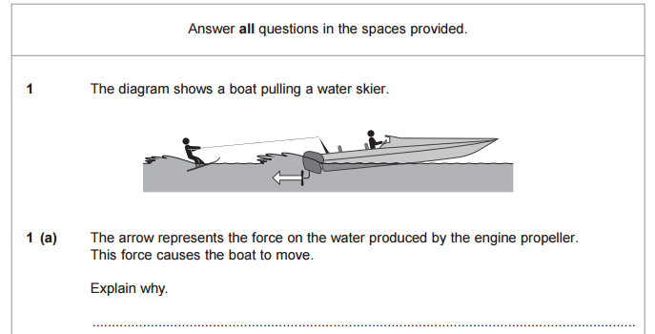

Slide 6
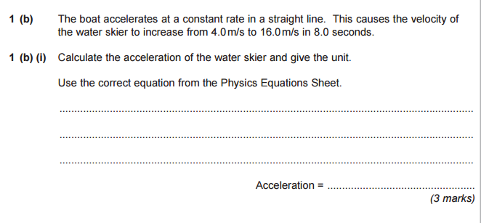

Slide 7
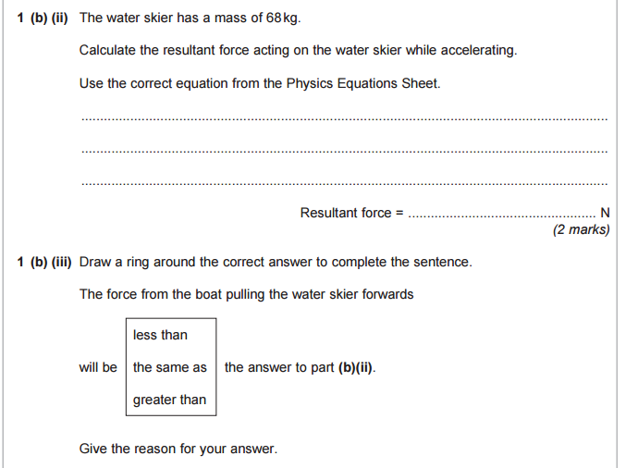

Slide 8
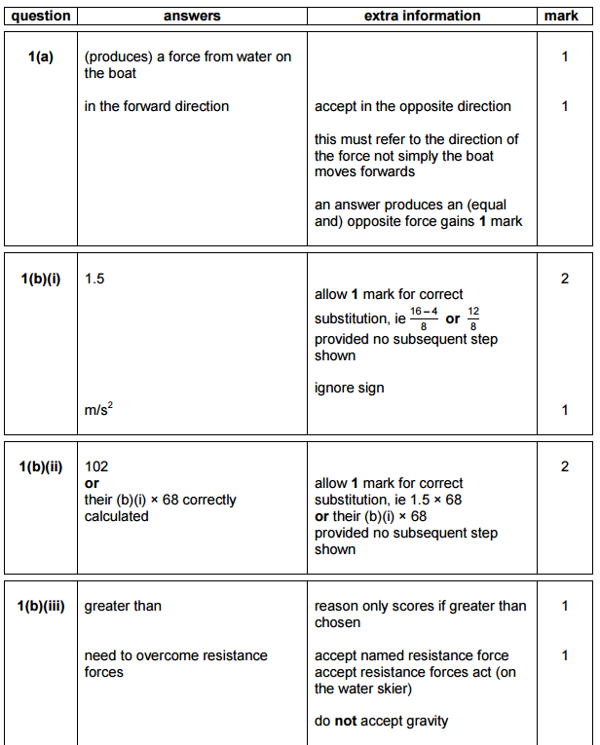
(Newton’s 3rd Law)

